Slide 1
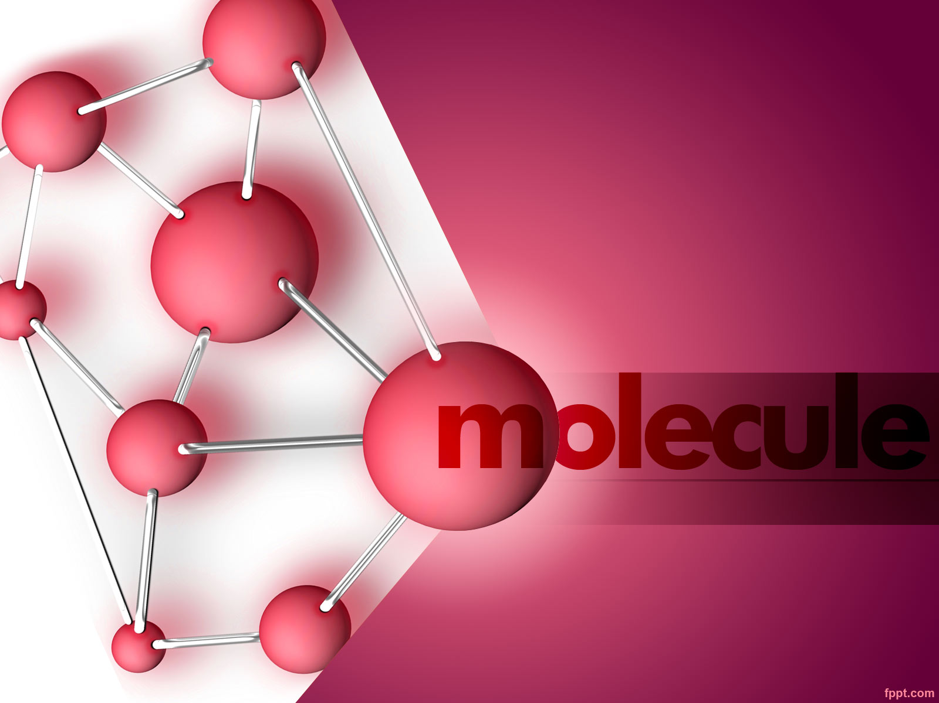
KDD Project Presentation
Team members:
Sampath Kumar Gunasekaran
Nitish Rangarajan
Yuvaraj Sundarrajan
Ajay Kumar Prathap
Shrutha Kashyap

Slide 2
PROBLEM STATEMENT
A managed healthcare organization believes they suffer from over $30 million in preventable losses annually due to the readmission of patients who are discharged from the hospital too soon.
AIM: To develop a model of readmission risk that doctors can consider when determining when to discharge a patient.

Slide 3
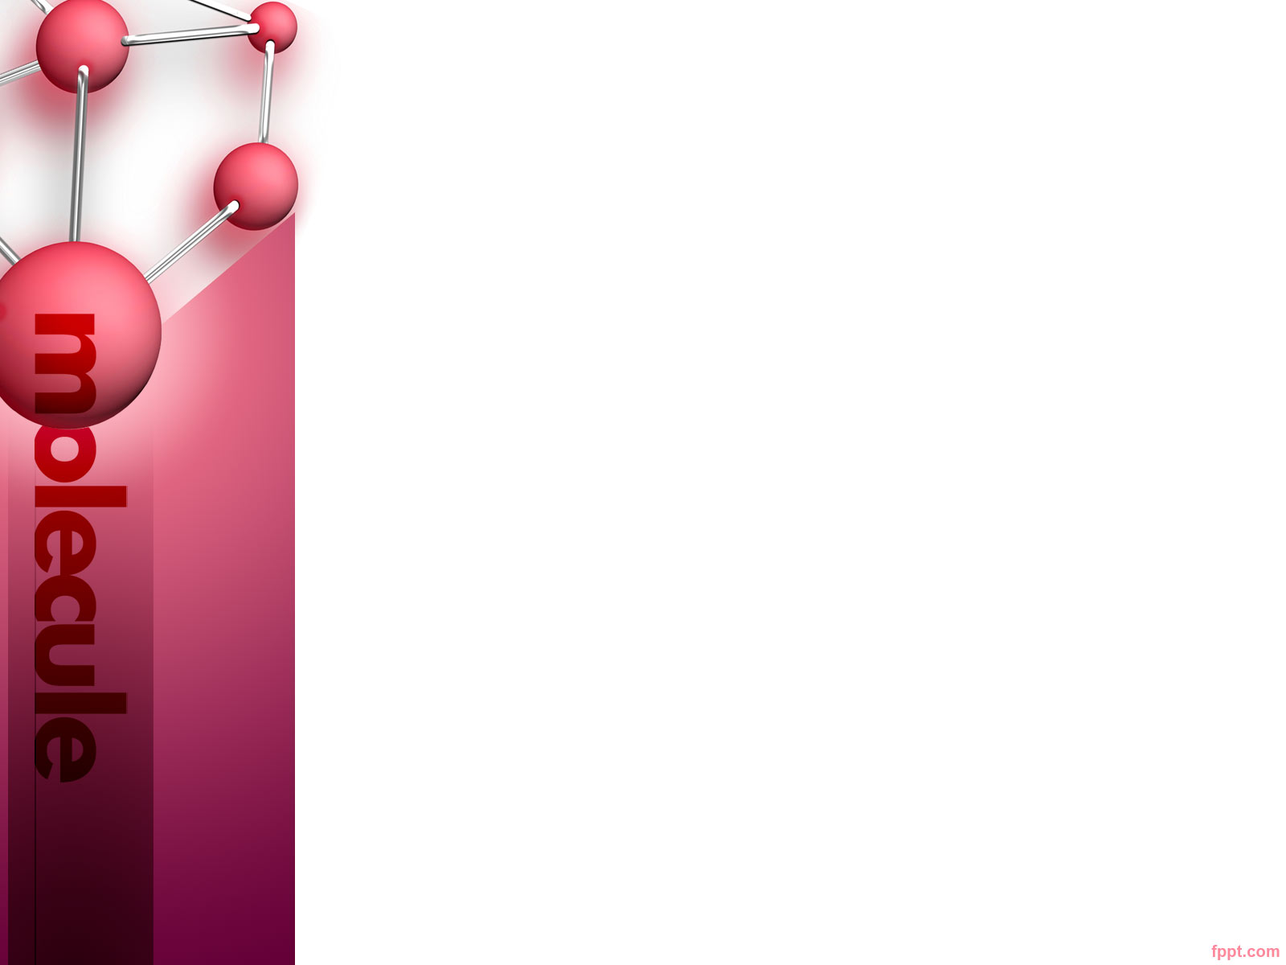
Initial Presentation Summary
Data Cleaning
Removing inconsistencies in Data
Correlation Analysis
Identifying Additional Tasks

Slide 4
Mid Term Presentation
Correlation Analysis
Regression Analysis
ANOVA
Principal Component Analysis

Slide 5
Analysis of Readmission Rate
Pattern Mining
Classification
Naïve Bayes
Decision Tree
Random Forest
Neural Networks
KNN
Logistic Regression

Slide 6
Pattern Mining
We used Apriori, a candidate generation and test approach for mining frequent patterns to predict readmission rate.
Initially, we got 42 associative rules

Slide 7
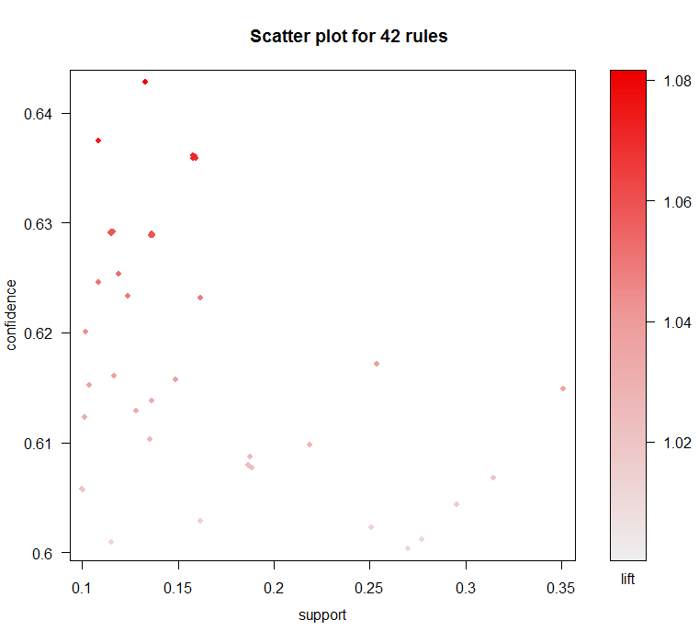

Slide 8
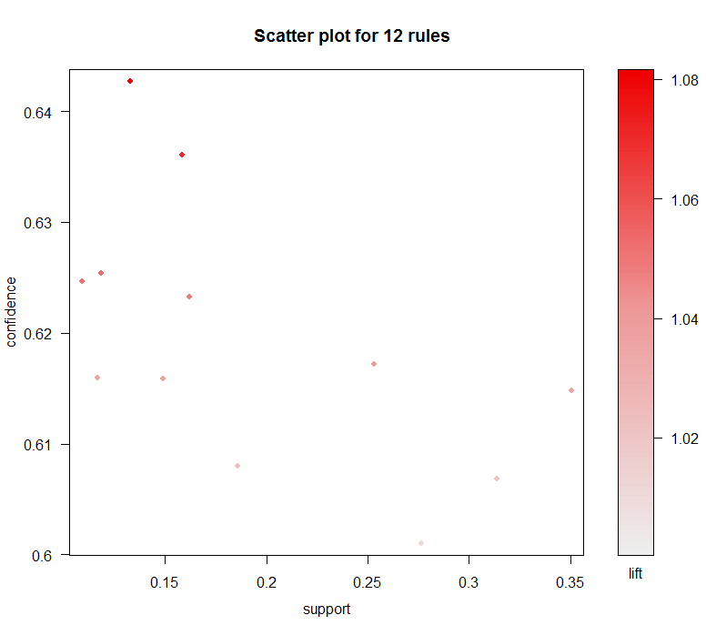
After Pruning redundant rules

Slide 9
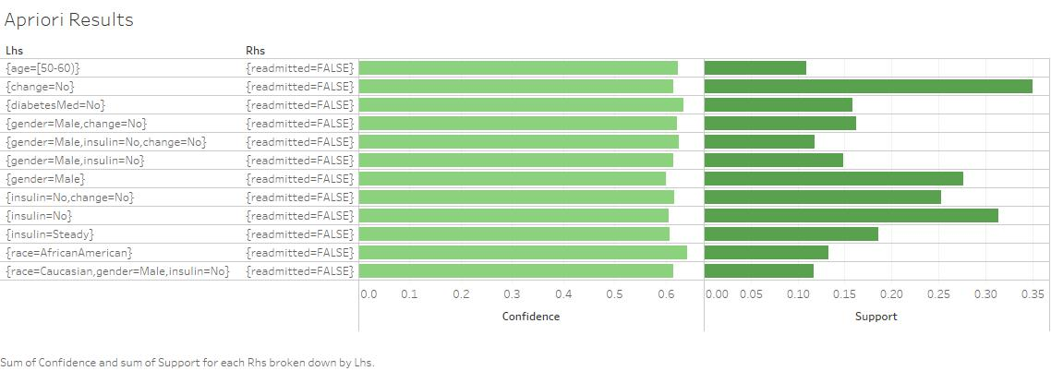
12 Associative rules for readmission

Slide 10
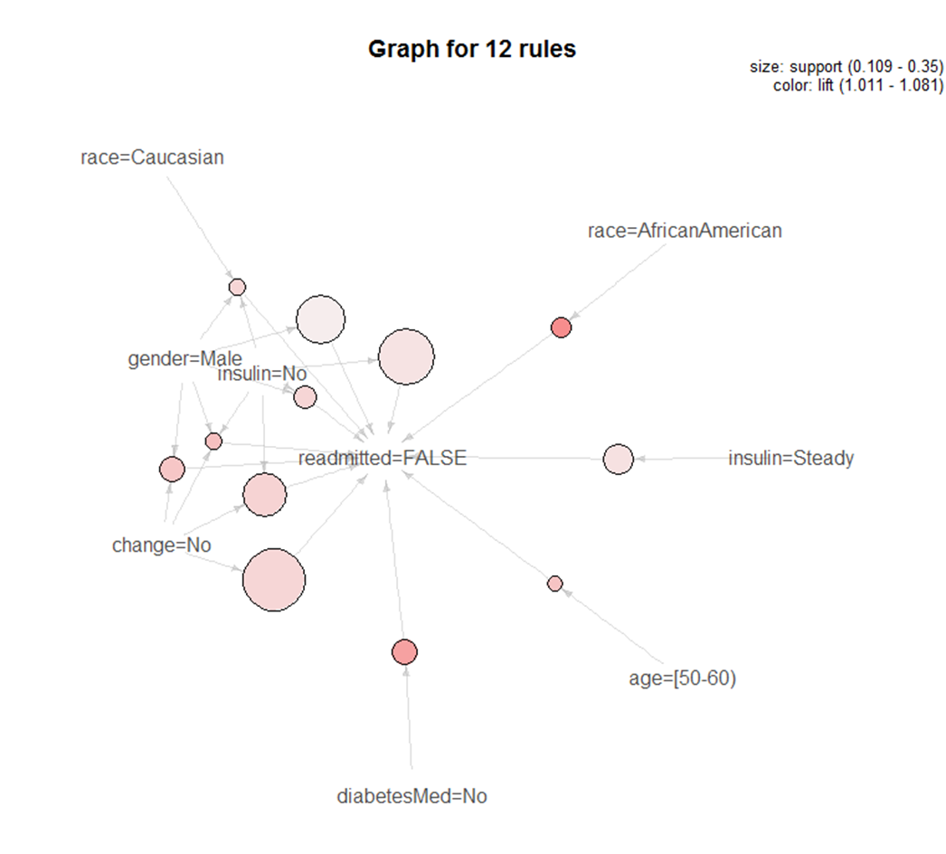
Balloon Plot

Slide 11
Classification Models
The following classification models are developed to predict categorical class labels which classifies data based on current set and uses it in classifying future data
Performance Evaluation:
Error Probability
Accuracy
Kappa Statistics

Slide 12
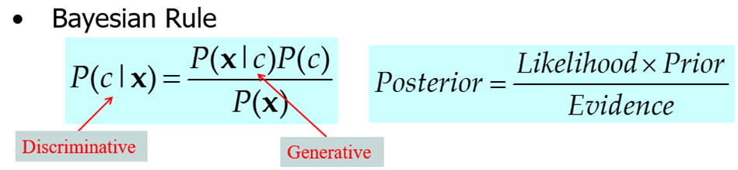
Naïve Bayes
Naïve bayes performs probabilistic prediction
We determine the probability of readmission given the values for all the other variables
Model has been predicted and it has been evaluated for accuracy
Accuracy: 66.25
Kappa: 0.2232

Slide 13
Decision Tree
Model of decisions and their possible consequences are represented in a tree format
Attributes are chosen based on the information gain
Splitting point is chosen using Gini Index
Model has been predicted and it has been evaluated for accuracy
Accuracy :60.56
Kappa: 0.0100

Slide 14
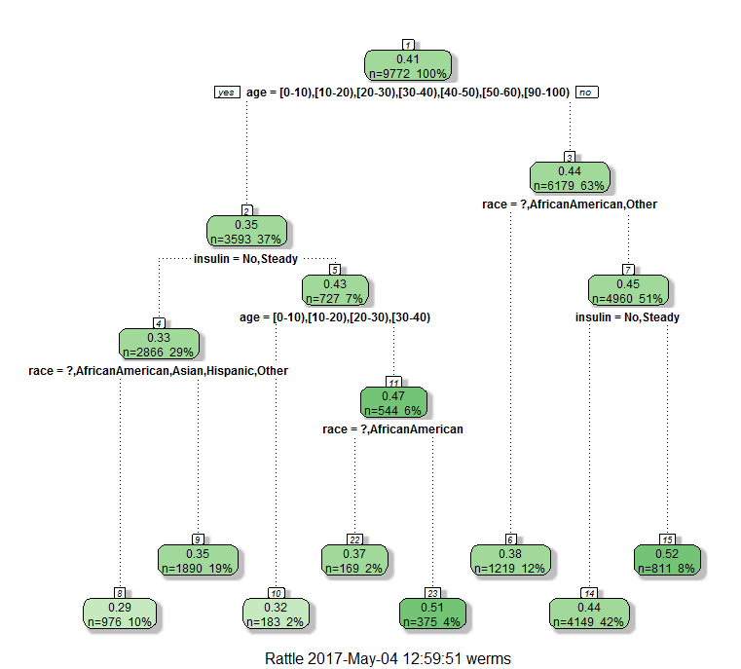
Decision Tree for Readmission

Slide 15
Random Forest
Model of decisions and their possible consequences are represented in a tree format
Attributes are chosen based on the information gain
Splitting point is chosen using Gini Index
Model has been predicted and it has been evaluated for accuracy
Accuracy: 59.33
Kappa: 0.0171

Slide 16
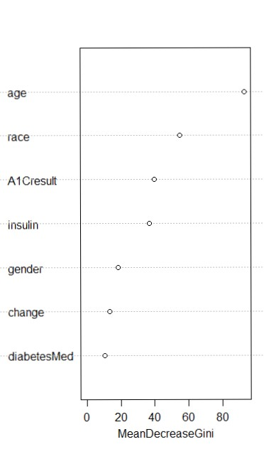
Mean Decrease Gini – Purity of the variable

Slide 17
Neural Network
Set of connected input and output units where each connection has a weight associated with it
Model has been predicted and it has been evaluated for accuracy
Accuracy: 63.19
Kappa: 0.0192

Slide 18
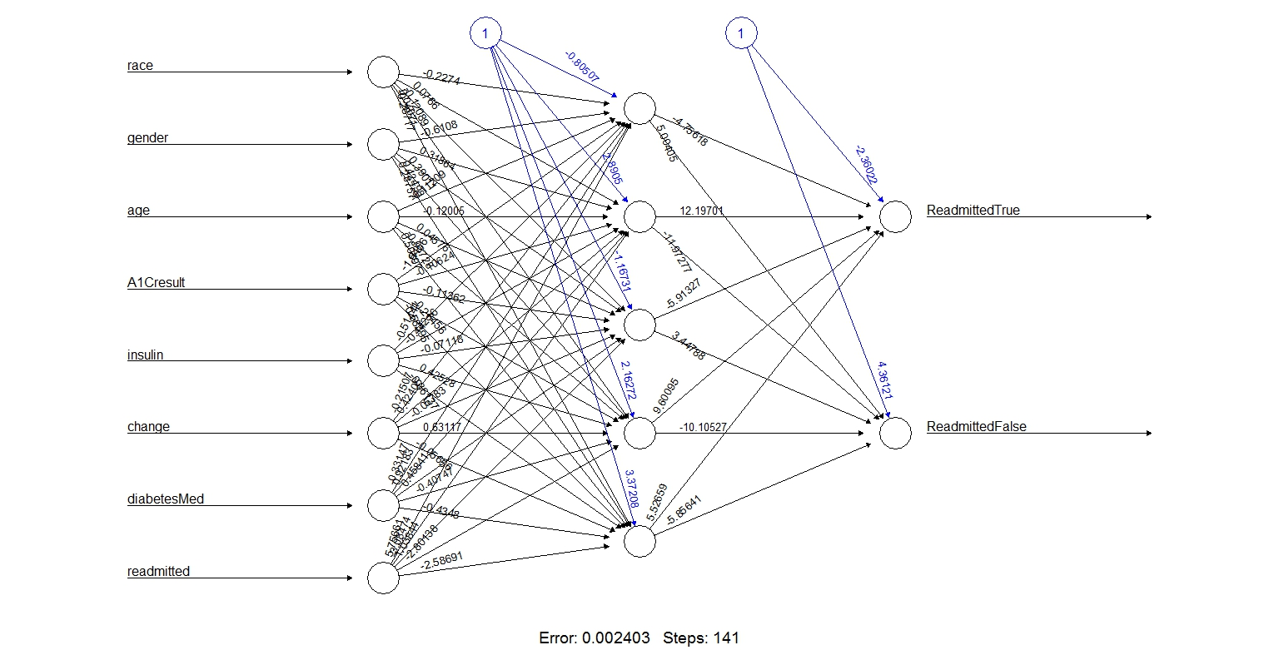
Neural Networks

Slide 19
KNN
Lazy Learning: less time in training but more time in predicting
Model has been predicted and it has been evaluated for accuracy

Slide 20
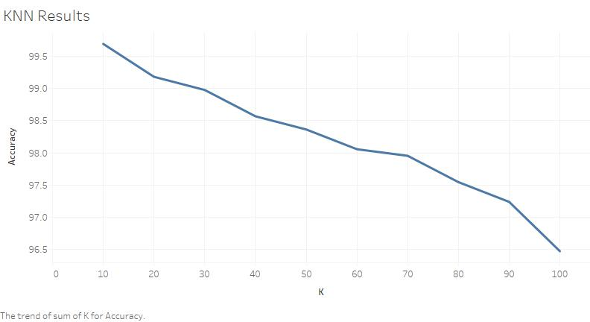
KNN Accuracy at different k values

Slide 21
Logistic regression
Models nominal outcome variable(Readmission rates).
We have visualized the model using ROC plot
Model has been predicted and it has been evaluated for accuracy
Accuracy: 64.23
Kappa: 0.0433

Slide 22
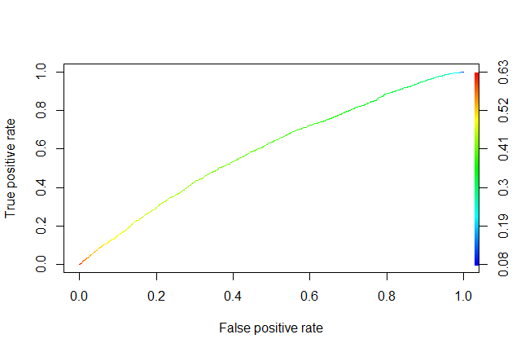
ROC curve

Slide 23
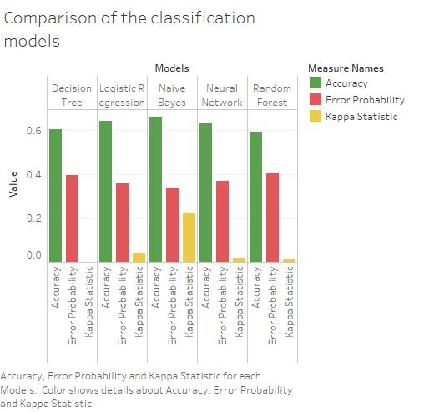

Slide 24
Clustering Analysis
Since the dataset also contains categorical variables, we used K-Modes instead of K-Means to cluster the similar set of patients.
Cluster Name | Readmitted | A1C result
Cluster 1 | False | >7,>8,Norm
Cluster 2 | False | None
Cluster 3 | True | >7,>8,Norm
Cluster 4 | True | None

Slide 25
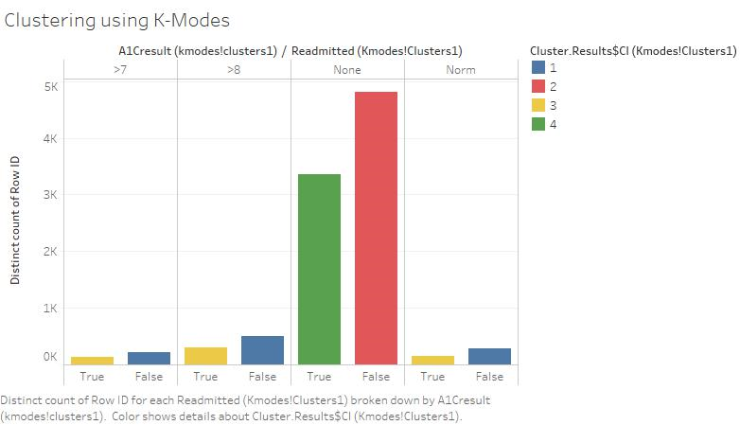

Slide 26
Task 1
How insulin and change in medication affects HbA1C result. WHY? This task helps prevent early readmission indirectly by monitoring the administration of medication and insulin levels that affect the HbA1C result. Some patients may choose not to take the HbA1C tests. Hence we could use insulin and change in medication to predict readmission. TECHNIQUES: Bayesian Network, Logistic Regression

Slide 27
Bayesian Network
We are using Bayesian network to find the conditional dependencies between A1C result, insulin, change in medication and readmission
Using these dependencies, we are finding the effects of insulin and change in medication of A1C result

Slide 28
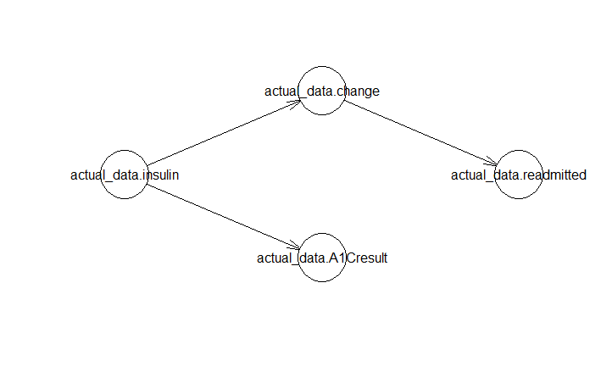
Bayesian Network Graph

Slide 29
Bayesian Network
We ran a few queries using the cpquery method for the event A1C result being None given different combination of values for insulin and change in medication as evidence

Slide 30
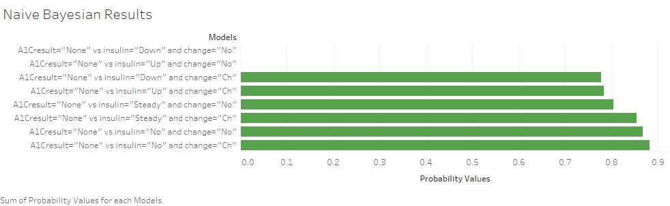
Cpquery results

Slide 31
Logistic Regression Analysis
The following regression models were developed:
Predicting the linear relationship between readmission rate(dependent variable) and HbA1C result (independent variable)
Predicting the linear relationship between readmission rate (dependent variable) and HbA1C result, insulin (independent variables)
Predicting the linear relationship between readmission rate (dependent variable) and HbA1C result, insulin, change in medication (independent variables)

Slide 32
ANOVA Results
Resid. Df | Resid. Dev | Df | Deviance
1 | 7813
2 | 7810 | 3 | -0.9486
3 | 7809 | 1 | -26.8344

Slide 33
Task 2
Predicting the likelihood of a non-diabetic patient being readmitted
WHY?
To find patterns of any non diabetic patient being readmitted.
The likelihood of a patient being readmitted is high when a patient has both circulatory disorder as well as diabetes. TECHNIQUES: Pattern Mining, Logistic Regression

Slide 34
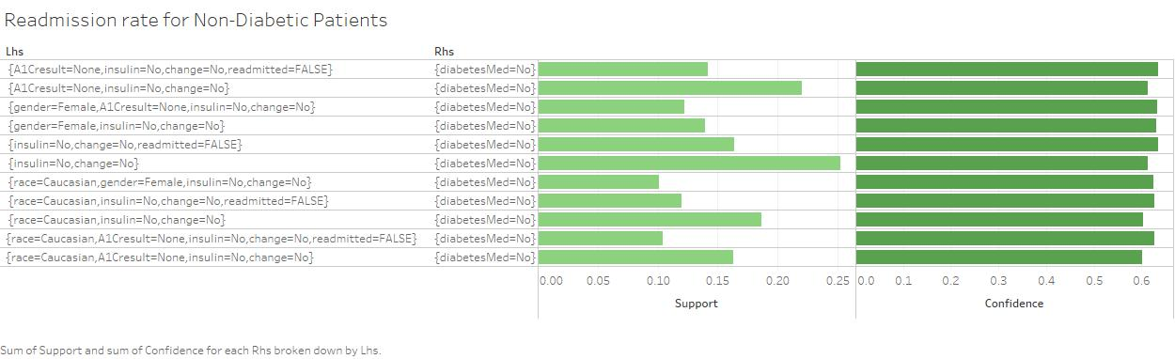
Pattern Mining - Associative Rules for Non-diabetic patients being readmitted

Slide 35
Logistic Regression
Logistic regression was run on the readmission data to determine the relationship between a non-diabetic patient getting readmitted.
The following regression models were developed:
Predicting the linear relationship between readmission rate(dependent variable) and primary diagnosis as diabetes (independent variable)
Predicting the linear relationship between readmission rate (dependent variable) and primary diagnosis as circulatory disorder, secondary diagnosis as diabetes (independent variables)

Slide 36
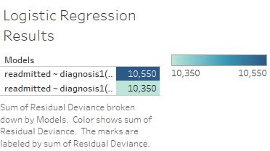
ANOVA Results

Slide 37
Challenges
Handling noise and missing values
Attribute selection for various models
Understanding the insights provided by all the classification models
Training the model to achieve better accuracy

Slide 38
Conclusion
By Chi-squared analysis, we found that the HBA1C results, influences the readmission rate.
By Logistic regression, we anticipate that A1C result, insulin and change in medication highly influences the readmission rate.
Using various classification models, we can predict the readmission rate of the future patients
By Bayesian network, even though A1C was not performed, we can use change in medication and insulin to predict readmission rate to a certain extent.
By clustering analysis, we envisage that the decision to test for A1C result, impacted the readmission rates rather than the actual values of the A1C result.

Slide 39
THANK YOU!

